Slide 1


Game Presentation
(01/2018)
Byelingual
Game story presentation
Notes:
It is a state when you speak 2 languages, but you start forgetting how to say things in both of them.
Instead of bilingual, it's byelingual.

Slide 2
Koohii Onegai
Phan Duc Anh
Vedran Brnjetic
Sontra Samela

Slide 3
Outline
Narrative structures
Game with multiple stories
A note on mechanics
Japanese language story
Finnish language story
Summary
References

Slide 4
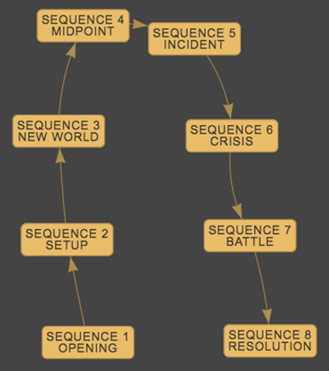
1. Narrative structures
linear narrative
Notes:
Linear structure

Slide 5
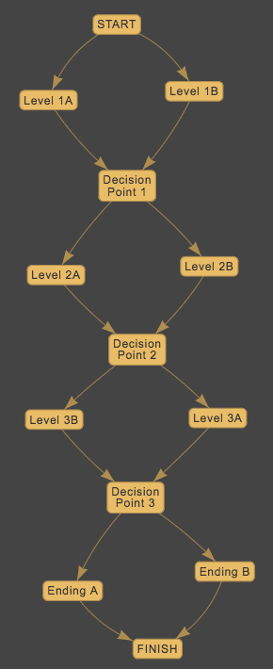
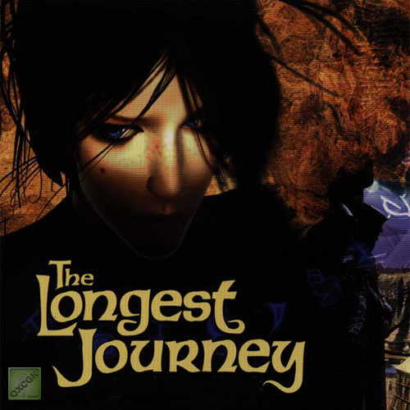

1. Narrative structures
parallel narrative For example, two characters whose fates are intertwined.
Notes:
Parallel structure

Slide 6
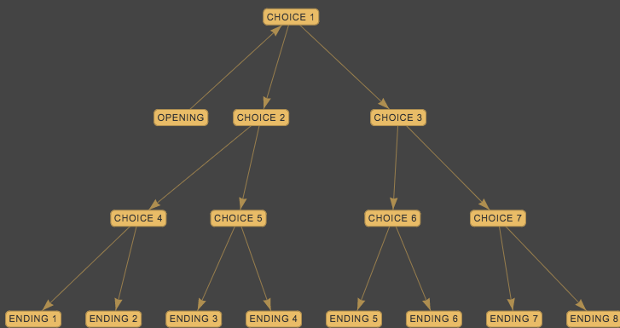
1. Narrative structures
The structure of stories in Byelingual: the branching narrative.
Notes:
Branching structure

Slide 7
2. Game with multiple stories
Why?
look like the novel/movie collection => player is the writer/director
any interactions => different stories
multi options => the personality of the player
multi stories intertwine => more interested

Slide 8
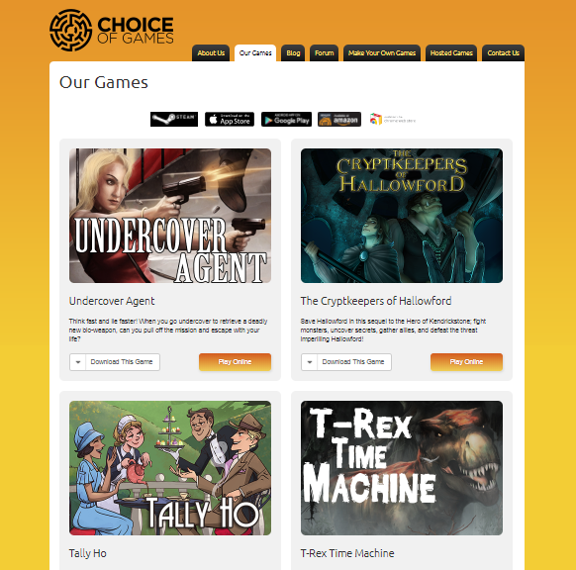
2. Game with multiple stories
Choice of Games, https://www.choiceofgames.com/ a game company and platform for writers and designers

Slide 9
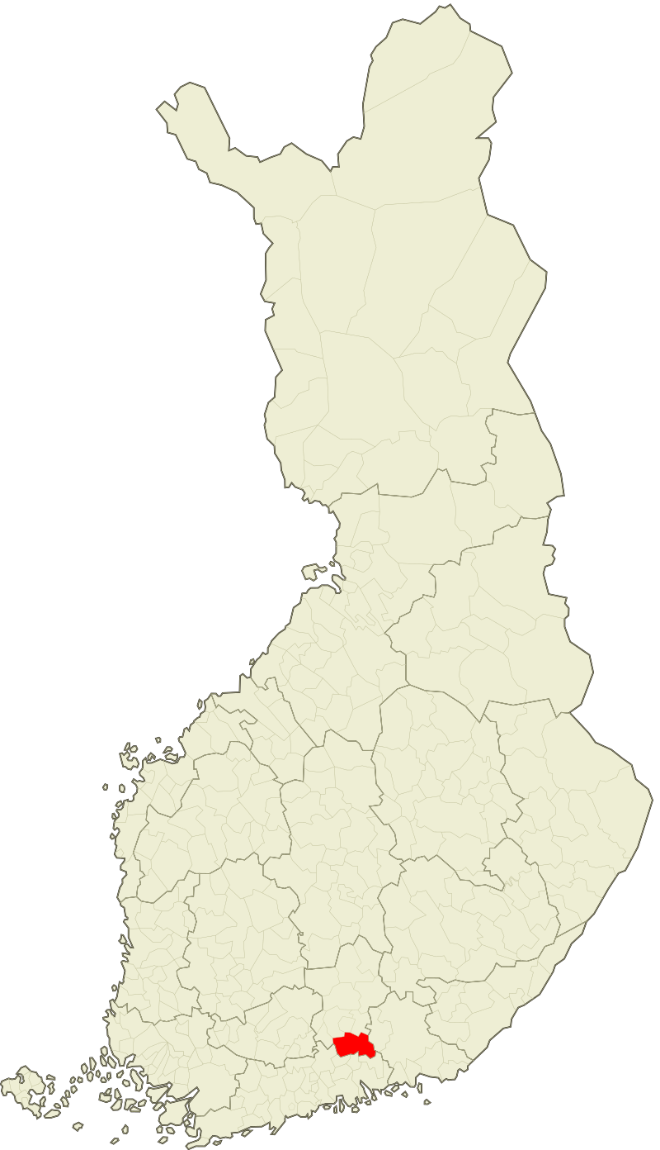
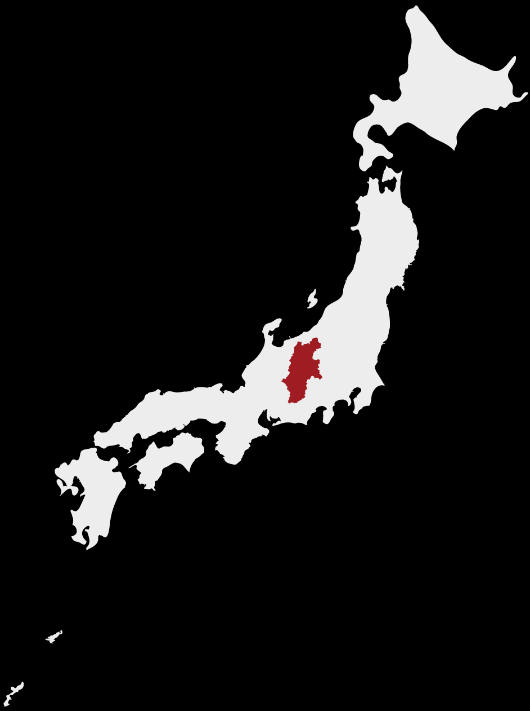
2. Game with multiple stories
A comedy of manners
tea ceremony has strict etiquette
mistaken identity
player unaware of his/her identity
A coming-of-age drama
the culmination of formative teenage rebellion in a group of junior high students
Notes:
We have two stories: One set in Japan and one set in Finland.

Slide 10
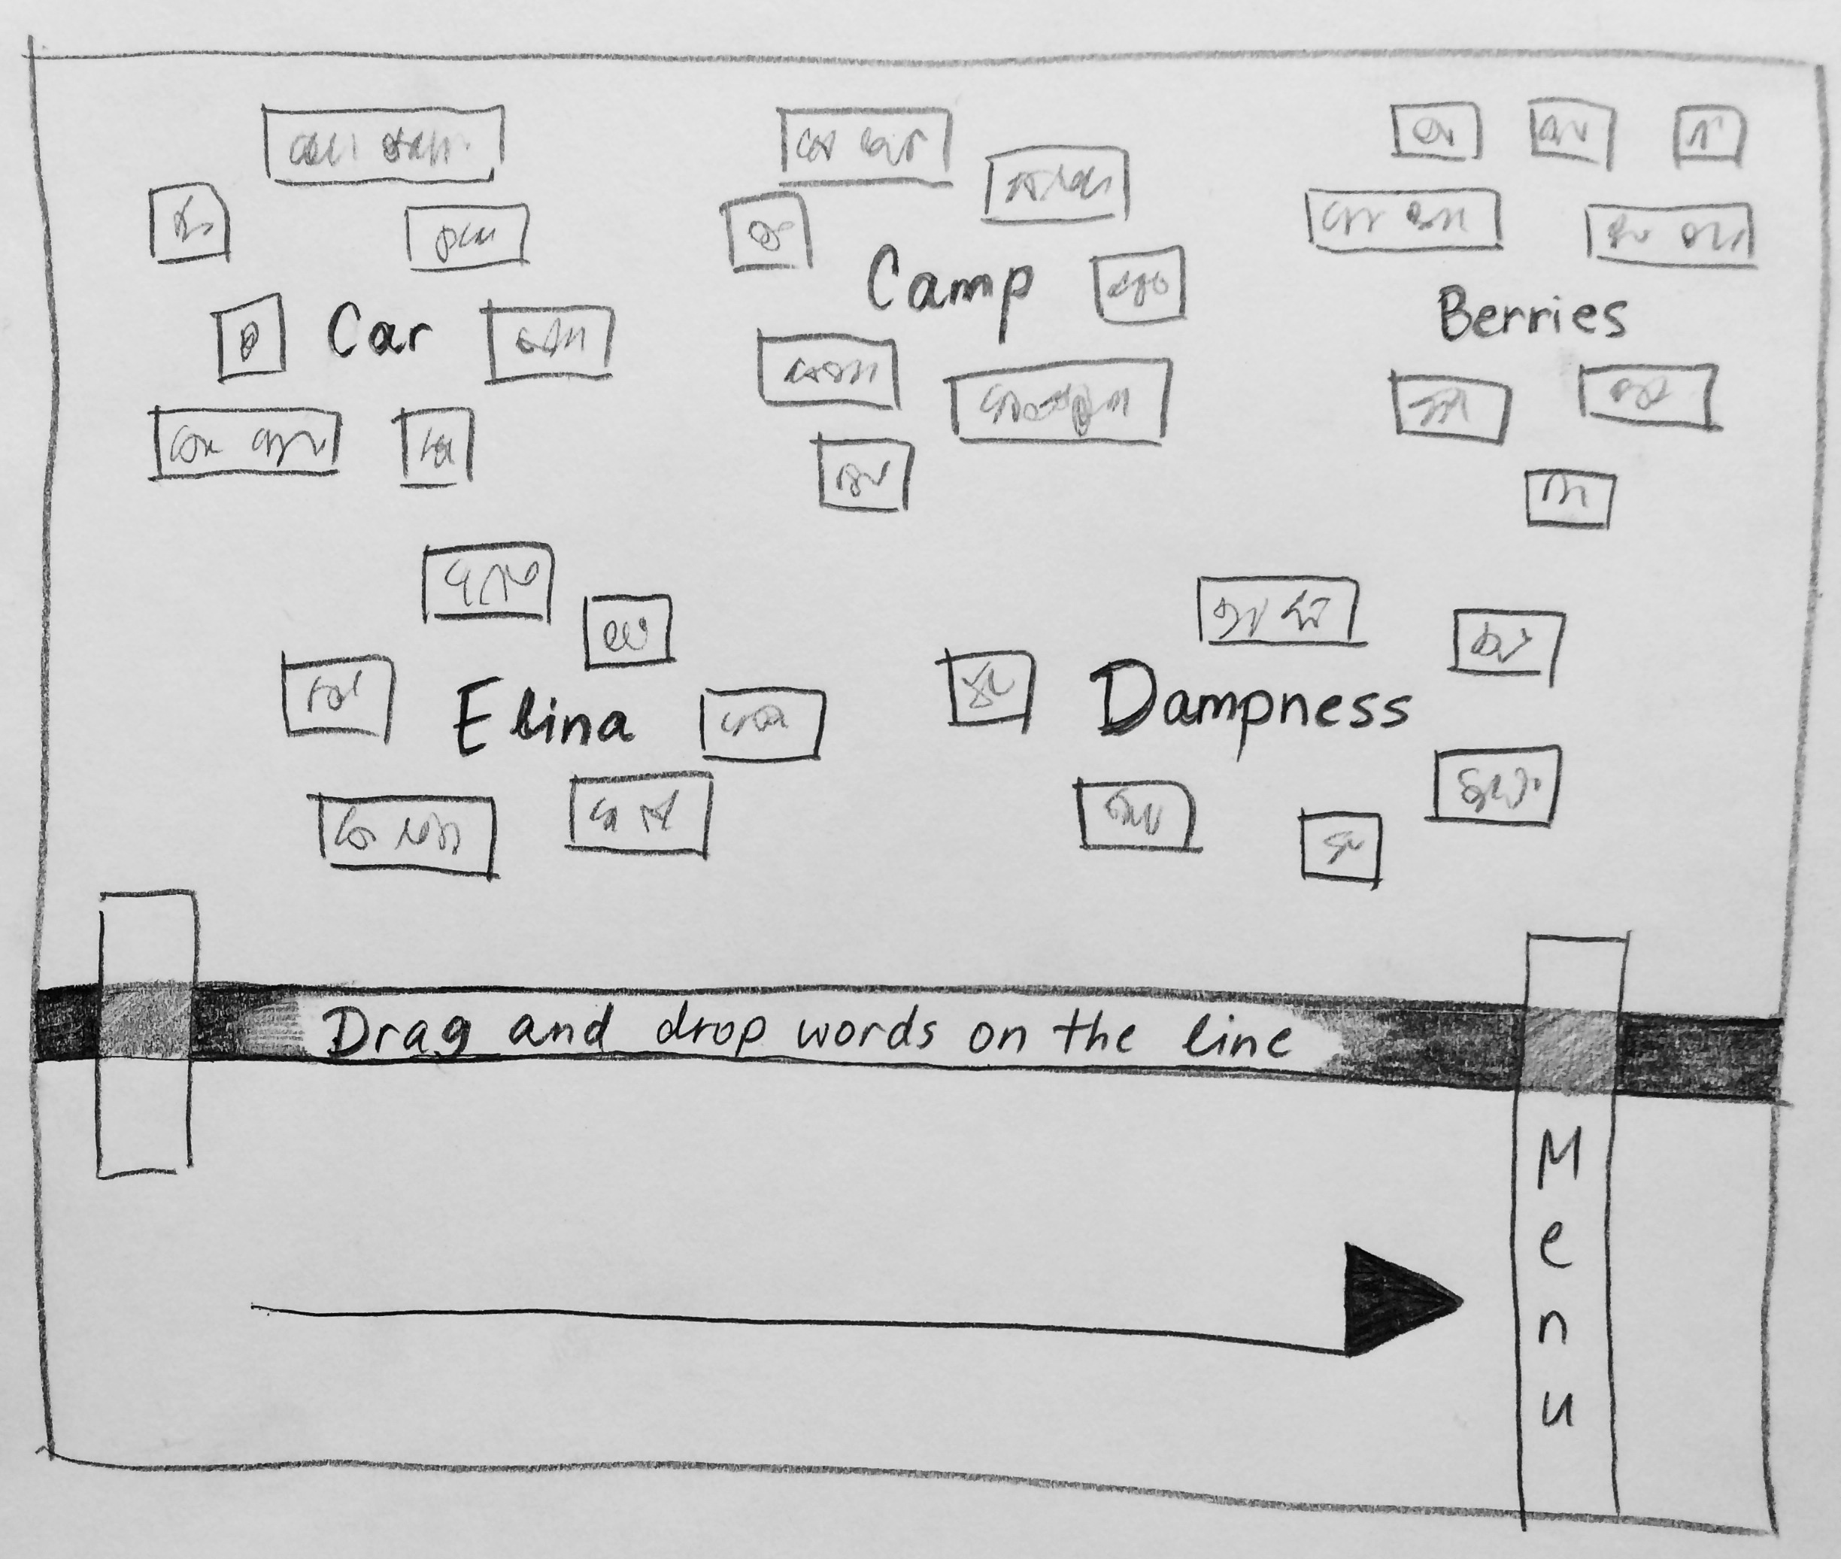
3. A note on mechanics
The stories are not actually in the target language.
The player must discover the story content hidden behind foreign dialogue and texts.
The language of the game is English.

Slide 11
4. Japanese language story
YOJIJUKUGO
Takes place in a manor
Spans one day
Four characters: the player + three non-player characters
The player has one of four identities:
Real estate agent
Suitor
Hitman
Fake hitman
Ten endings

Slide 12
4. Japanese language story
Act 1
Player is free to move around and interact with game world objects
Objects bring up choices
Each choice grants +/- identity points
Act 2
Linear tea ceremony sequence
Choices during tea ceremony determine final ending
Act 3
Final ending
Identity revealed

Slide 13
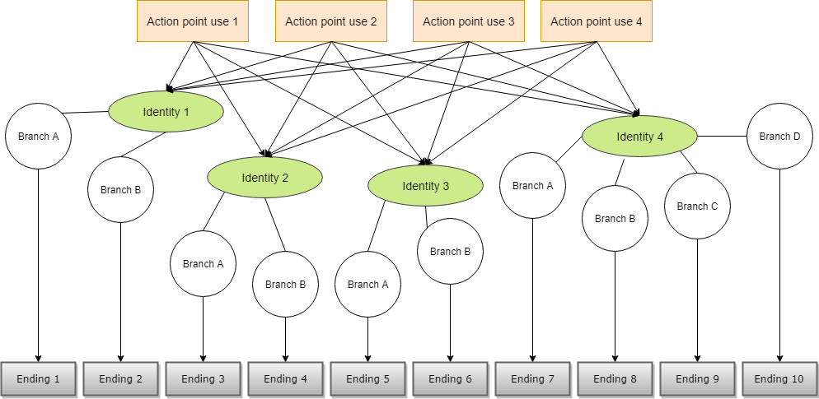
4. Japanese language story

Slide 14
4. Japanese language story
The path of the Fake Hitman
You saw an opportunity and you seized it: a new identity
The real Hitman hit his head, fell in a coma, and lost his memory
All you wanted was to escape your own miserable life
But now you have a choice ahead of you: Fulfill the latest contract, or remain a flimsy fake
2 endings

Slide 15
4. Japanese language story
The path of the Hitman
You really did lose your memory, actually
But now it’s back
And that lowlife is sitting in your chair
Eating your cornflakes
Funny, he doesn’t recognize you
What to do with him?
2 endings

Slide 16
4. Japanese language story
The path of the Suitor
The manor owner has a daughter, and you are engaged to her
Today is your chance to prove your worth to Father-in-law
But what’s this, another guest at the tea ceremony?
Why today of all days?
Is he a rival suitor?!
Or something else…
4 endings

Slide 17
4. Japanese language story
The path of the Real Estate Agent
Someone’s in big trouble
They want to sell their family estate, fast
Must owe a lot of money somewhere…
But it’s none of your concern
You’re just here to do your job
As you always have been, year after year, day by day, week in week out, quarter followed by quarter, from cover to cover of each annual report…
2 endings

Slide 18
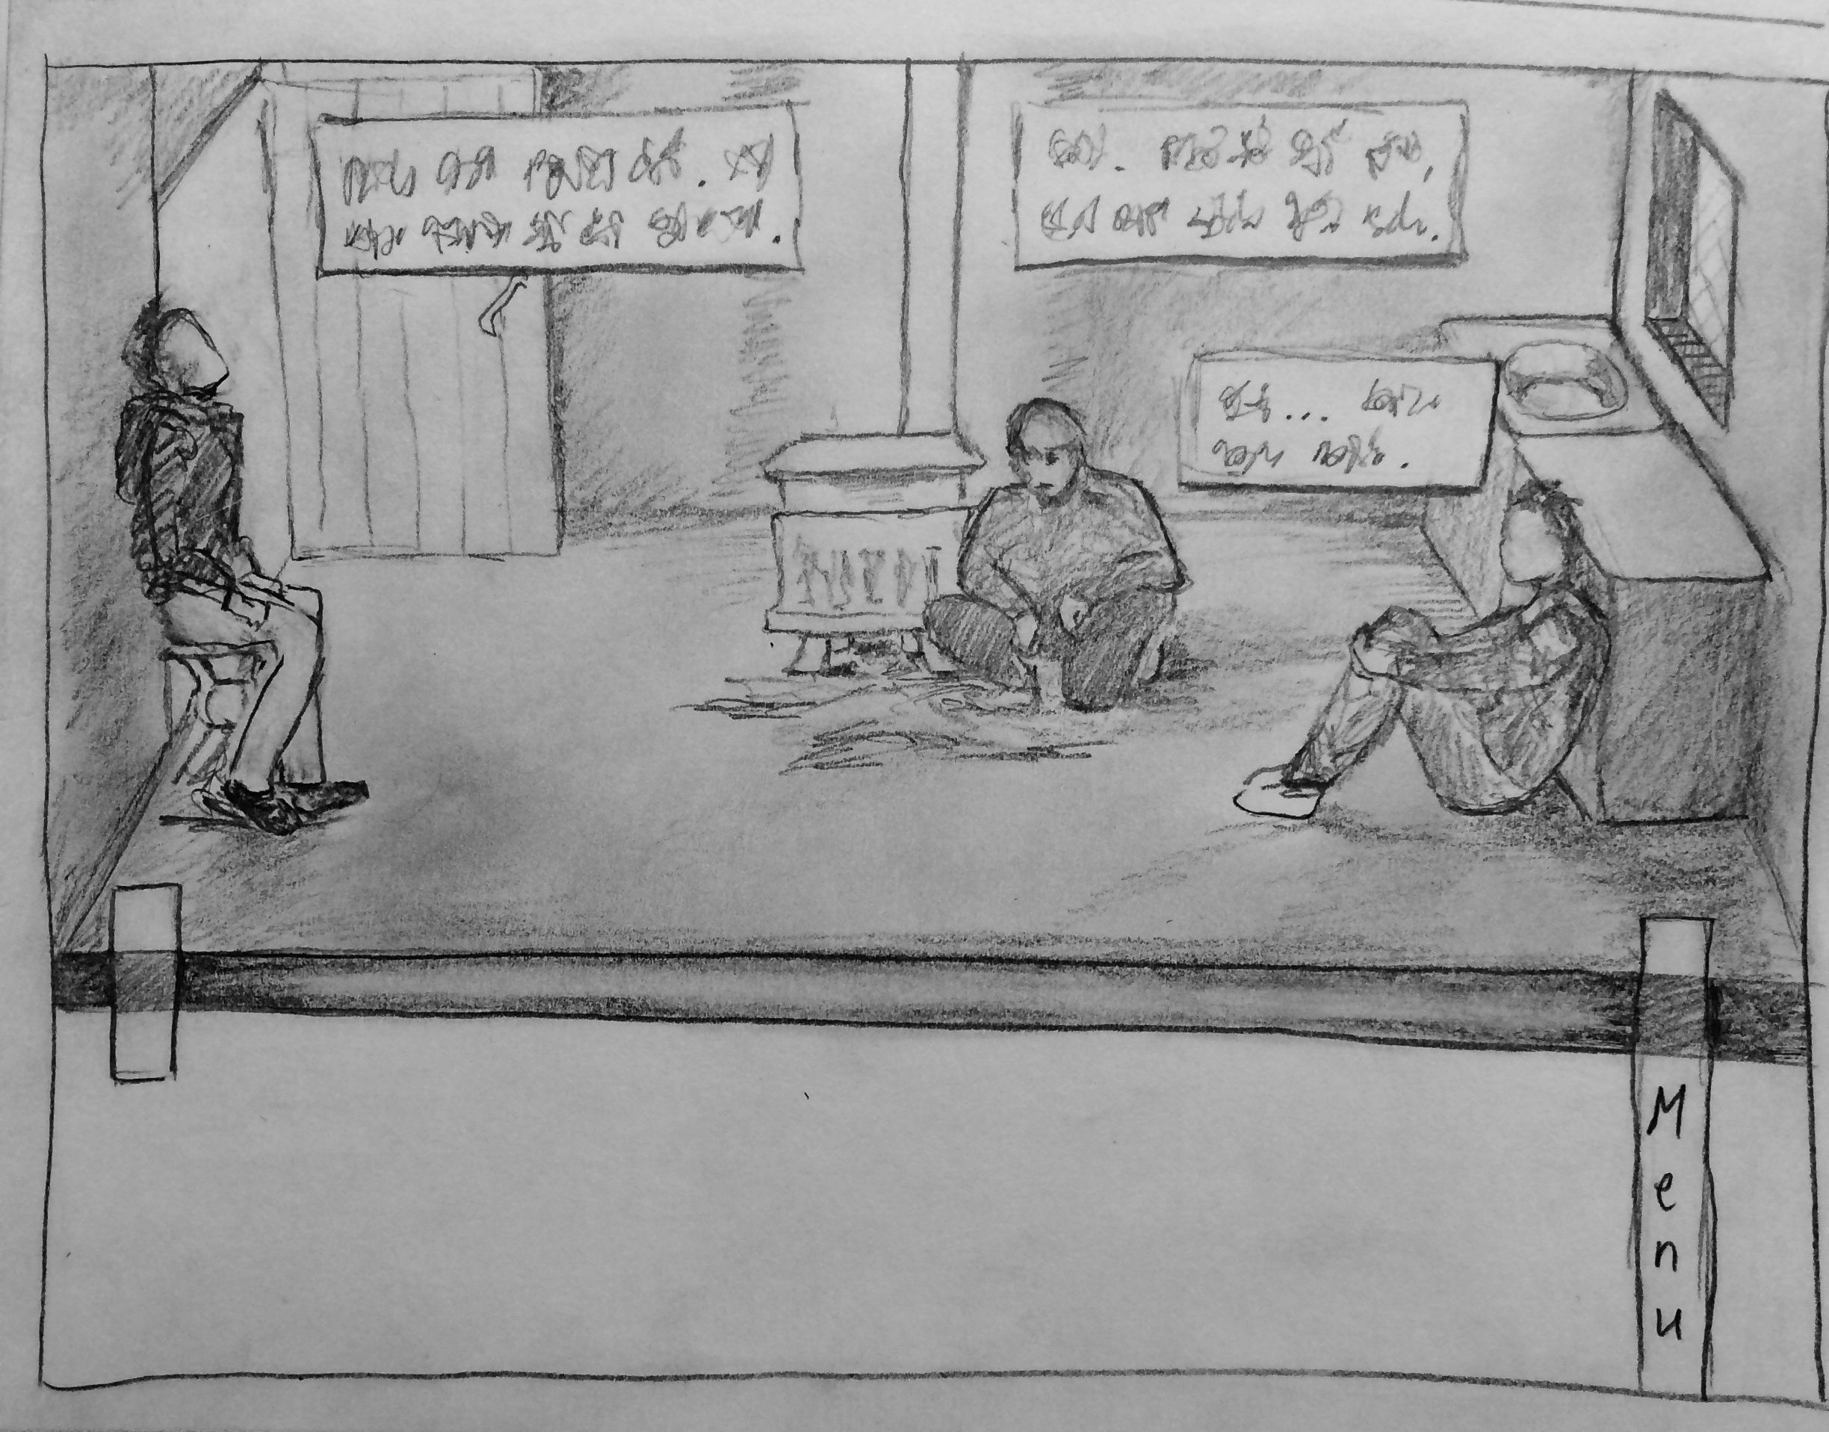

Slide 19
5. Finnish language story
CABIN IN THE WOODS
Takes place in the surroundings of the cabin
Spans three days
Six characters: the player + five non-player characters
Annika
Juhani
Elina
Aate
Tuomo
Five endings

Slide 20
5. Finnish language story
Act 1
Player is free to move around and interact with game world objects
Objects bring up choices
Choices provide hints for NPC dialogue
Dialogue leads to flashbacks
Flashbacks give more hints for more NPC dialogue
Act 2
Linear ending sequence
Special ending if player unlocked it in NPC dialogue
Otherwise default ending

Slide 21
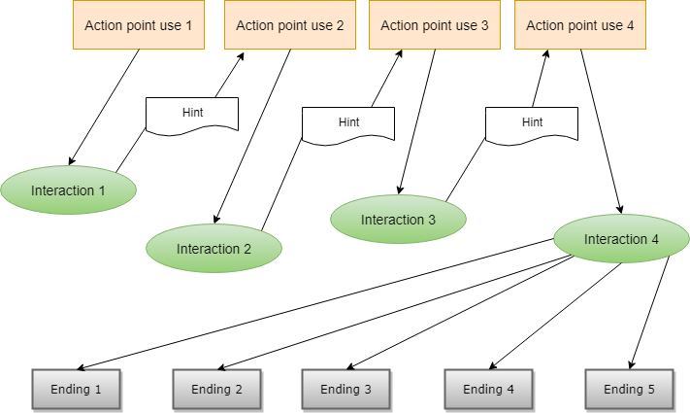
5. Finnish language story

Slide 22
5. Finnish language story
Premise
You find yourself in a rotting cabin surrounded by other kids your age
This place was clearly abandoned a long time ago
Yet the other kids don’t seem to be in a hurry to leave
There’s restlessness, tension, frenzy, even anger in the air
What is keeping them here?
If only you could remember the words...

Slide 23
5. Finnish language story
Endings
Default ending: The cabin burns down, and one youth perishes.
Juhani & Annika ending: You convince Juhani to alert the youth camp authorities.
Elina ending: You convince Elina to believe in herself.
Aate ending: You find out about Aate’s difficult relationship to his father.
Tuomo ending: You accidentally encourage Tuomo’s destructive and vandalistic tendencies.

Slide 24
6. Summary
BYELINGUAL
Many stories
Complex narrative structures
Common feature: branched endings
2 or 3 acts
Player motivation: seeing all the endings

Slide 25
7. References
In order of appearance
“How To Structure A Game Story” by Celtx on CeltxBlog (2017) https://blog.celtx.com/how-to-structure-a-game-story/
“The Longest Journey” (1999) and “Dreamfall: The Longest Journey” (2006) by Funcom https://www.funcom.com/
Choice of Games LLC website (2018) https://www.choiceofgames.com/
“Nagano Prefecture” by Japan National Tourism Organization (2018) https://www.jnto.go.jp/eng/regional/nagano/index.html
“Orimattila” by Wikipedia contributors (2017) https://en.wikipedia.org/wiki/Orimattila

Slide 26

Questions?

